Slide 1

Carrying Capacity & The Tourism Paradox
Ella Strachan, Ann Sharma, Jarwin Sharma, Shae Llewellyn

Slide 2
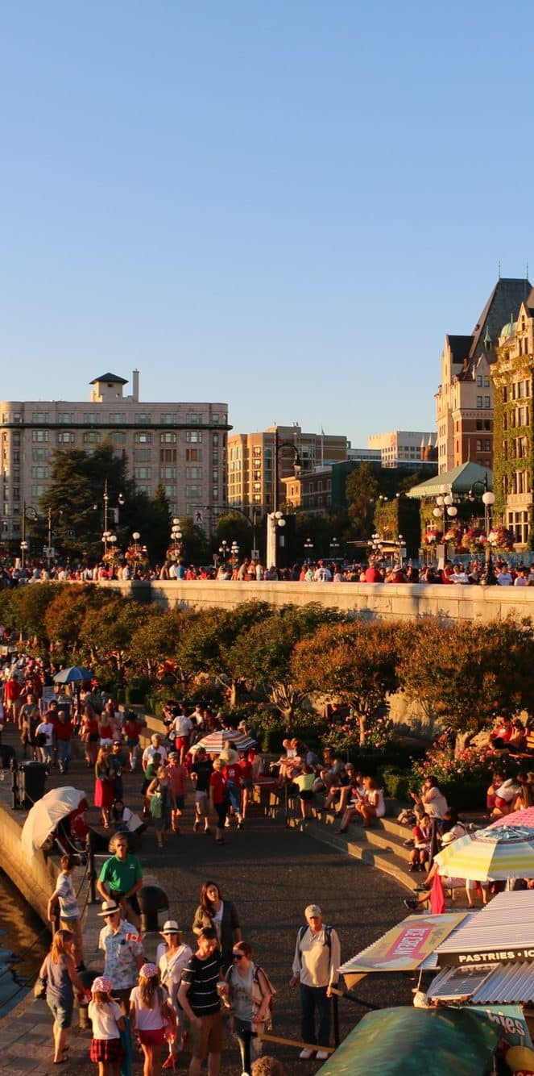
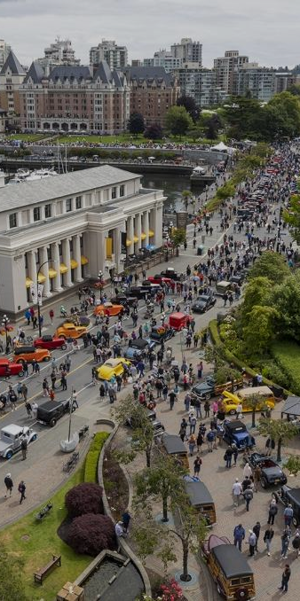
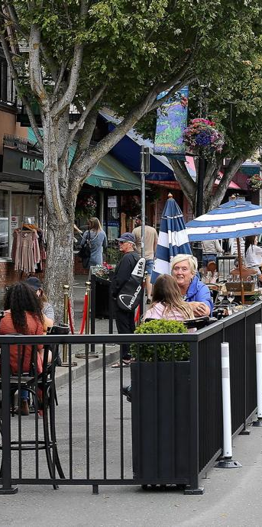
The Inner Harbour Bottleneck
Victoria’s Inner Harbour Sees Record breaking Tourism Traffic
This leads to transportation issues for locals and the disneyfication of downtown
Other Areas in Victoria remain largely unvisited and do not benefit from tourism
Many tourists do not enjoy large crowds but struggle to find areas to explore other than downtown
This 5 block area receives the greatest density of tourist traffic

Slide 3
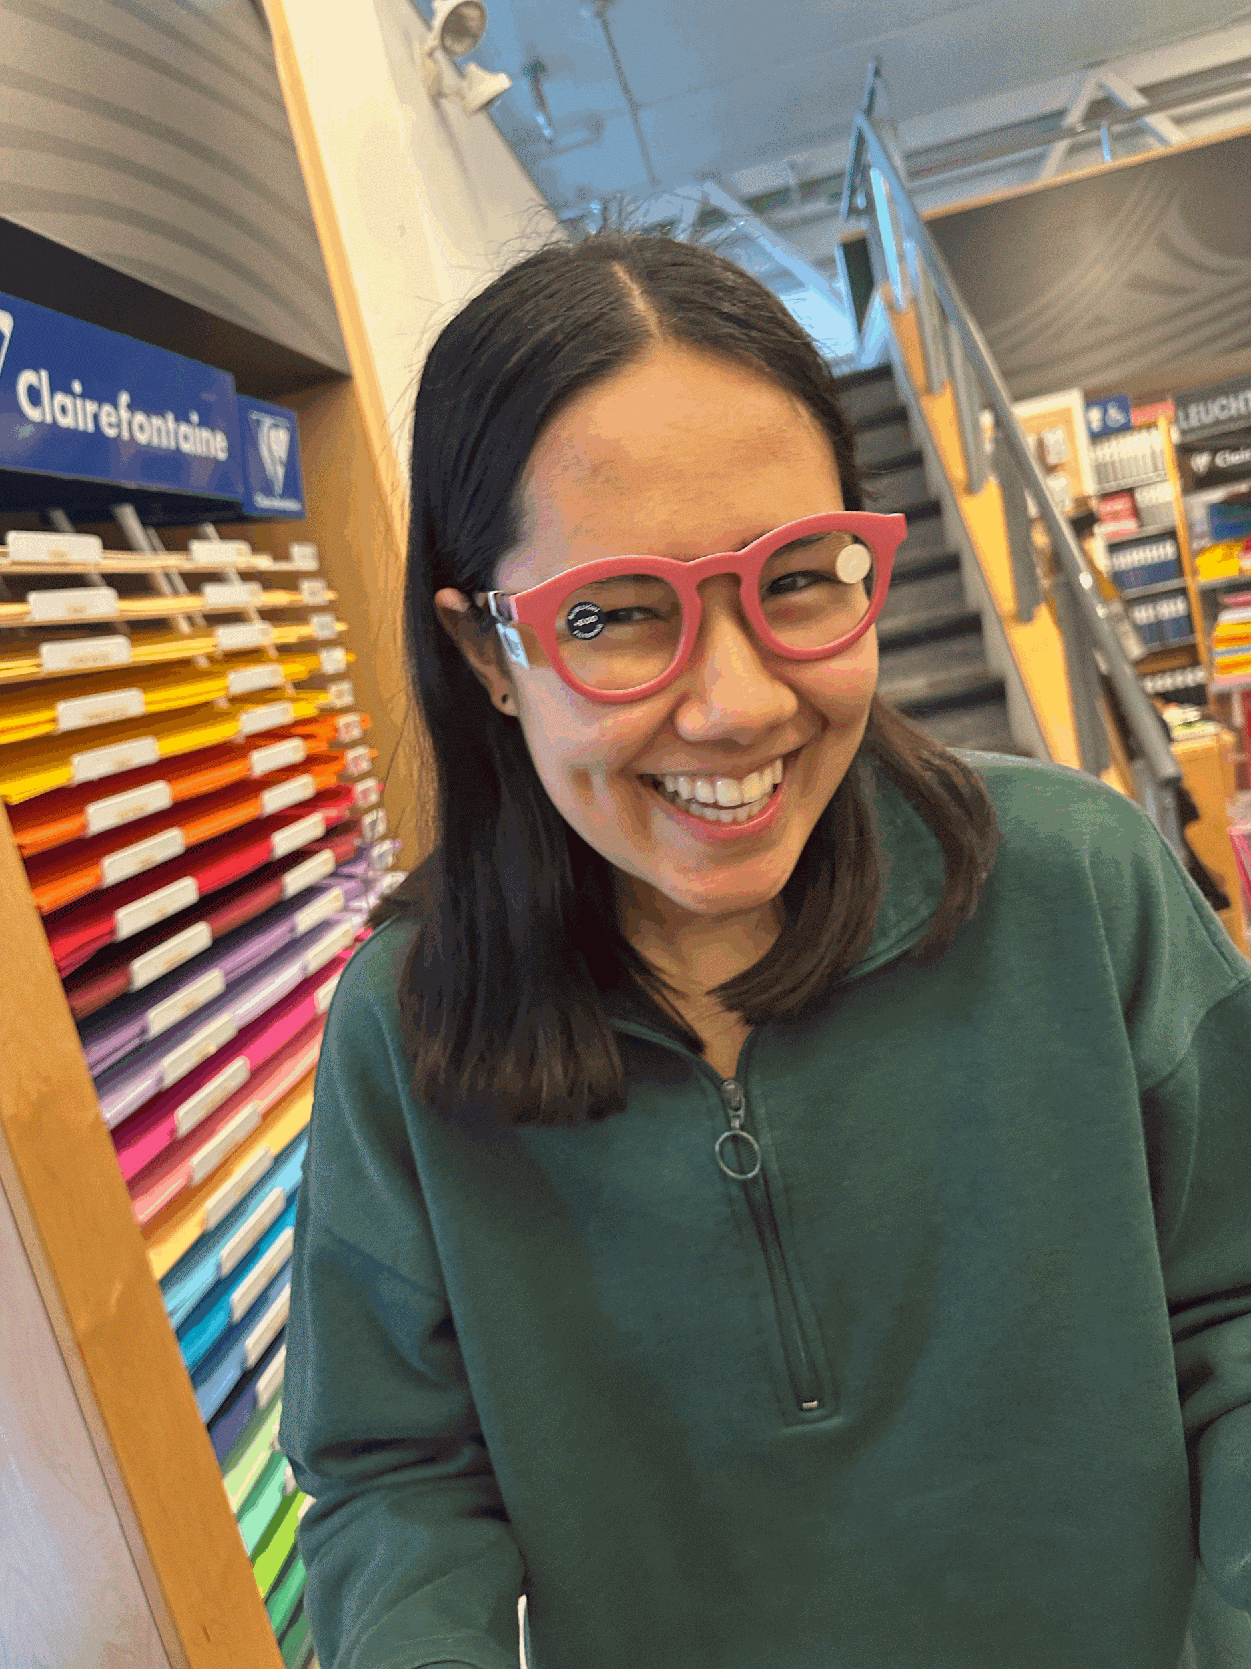
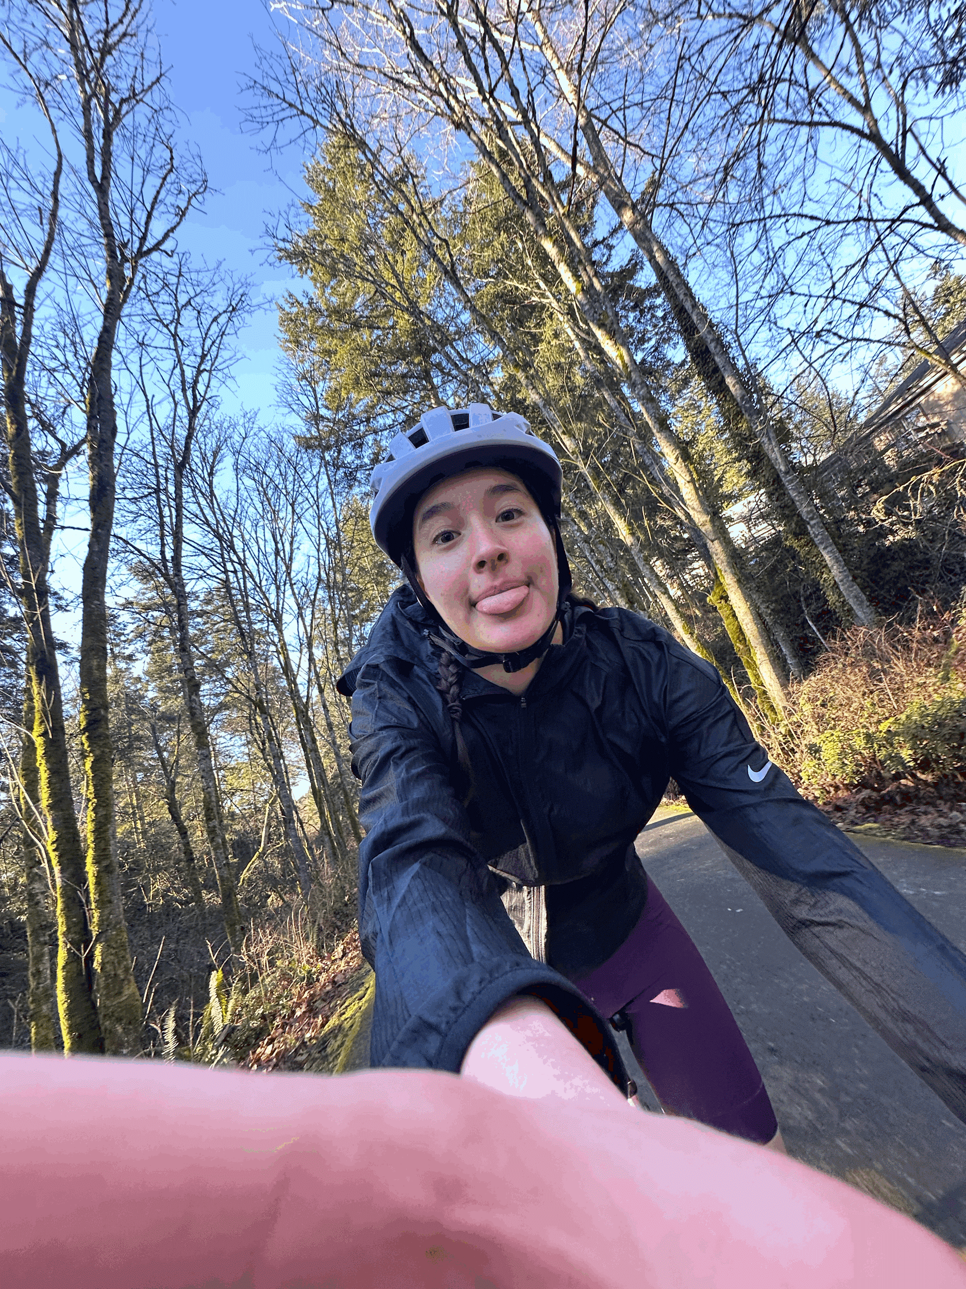
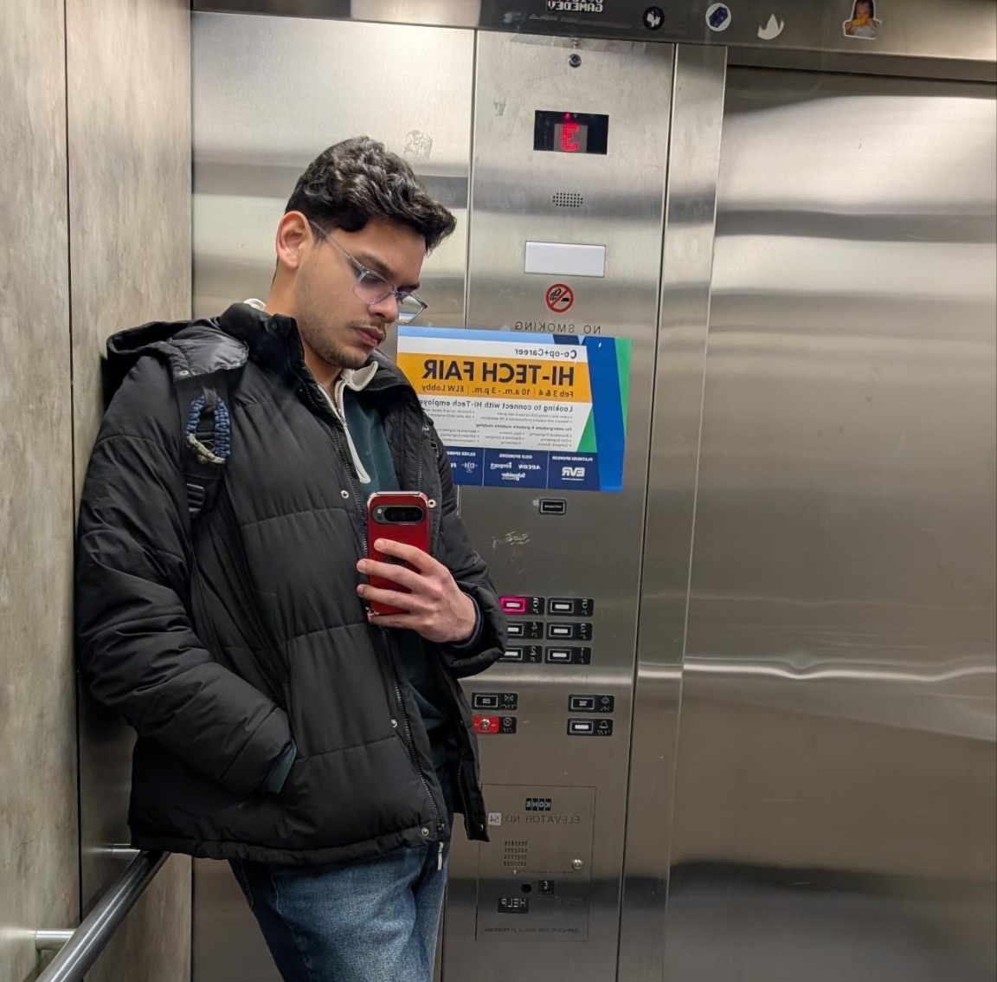

Our IDEA
Locals
Tourism app to “Explore Victoria like a local”
Goal: Distribute tourism traffic from high density areas (Downtown) by recommending less busy areas to visit
Many hidden gems frequented by locals go undiscovered by tourists
Our app can help small businesses and neighbourhoods become more popular while decreasing high density areas
Solves the issue of “What to do today?”

Slide 4
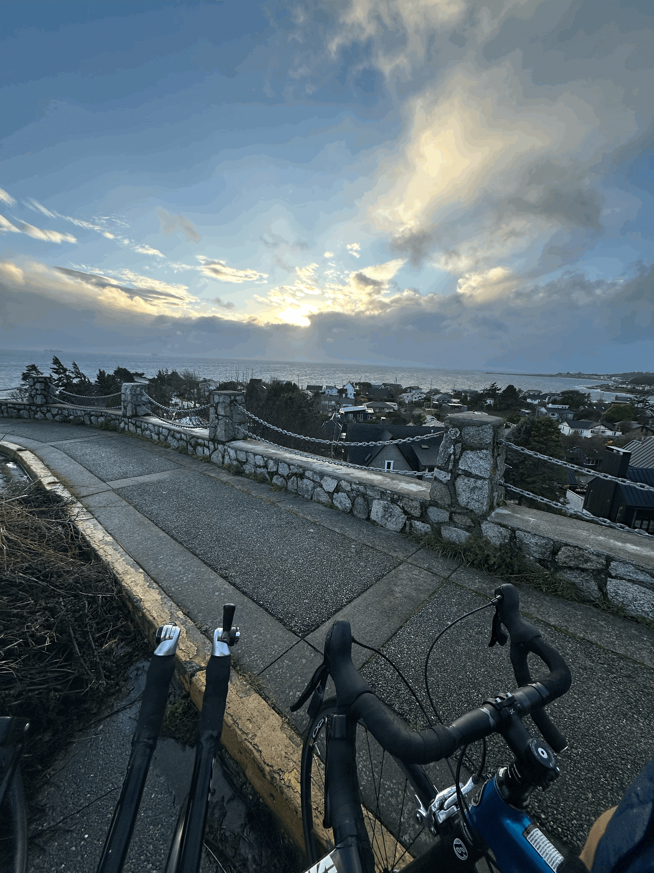
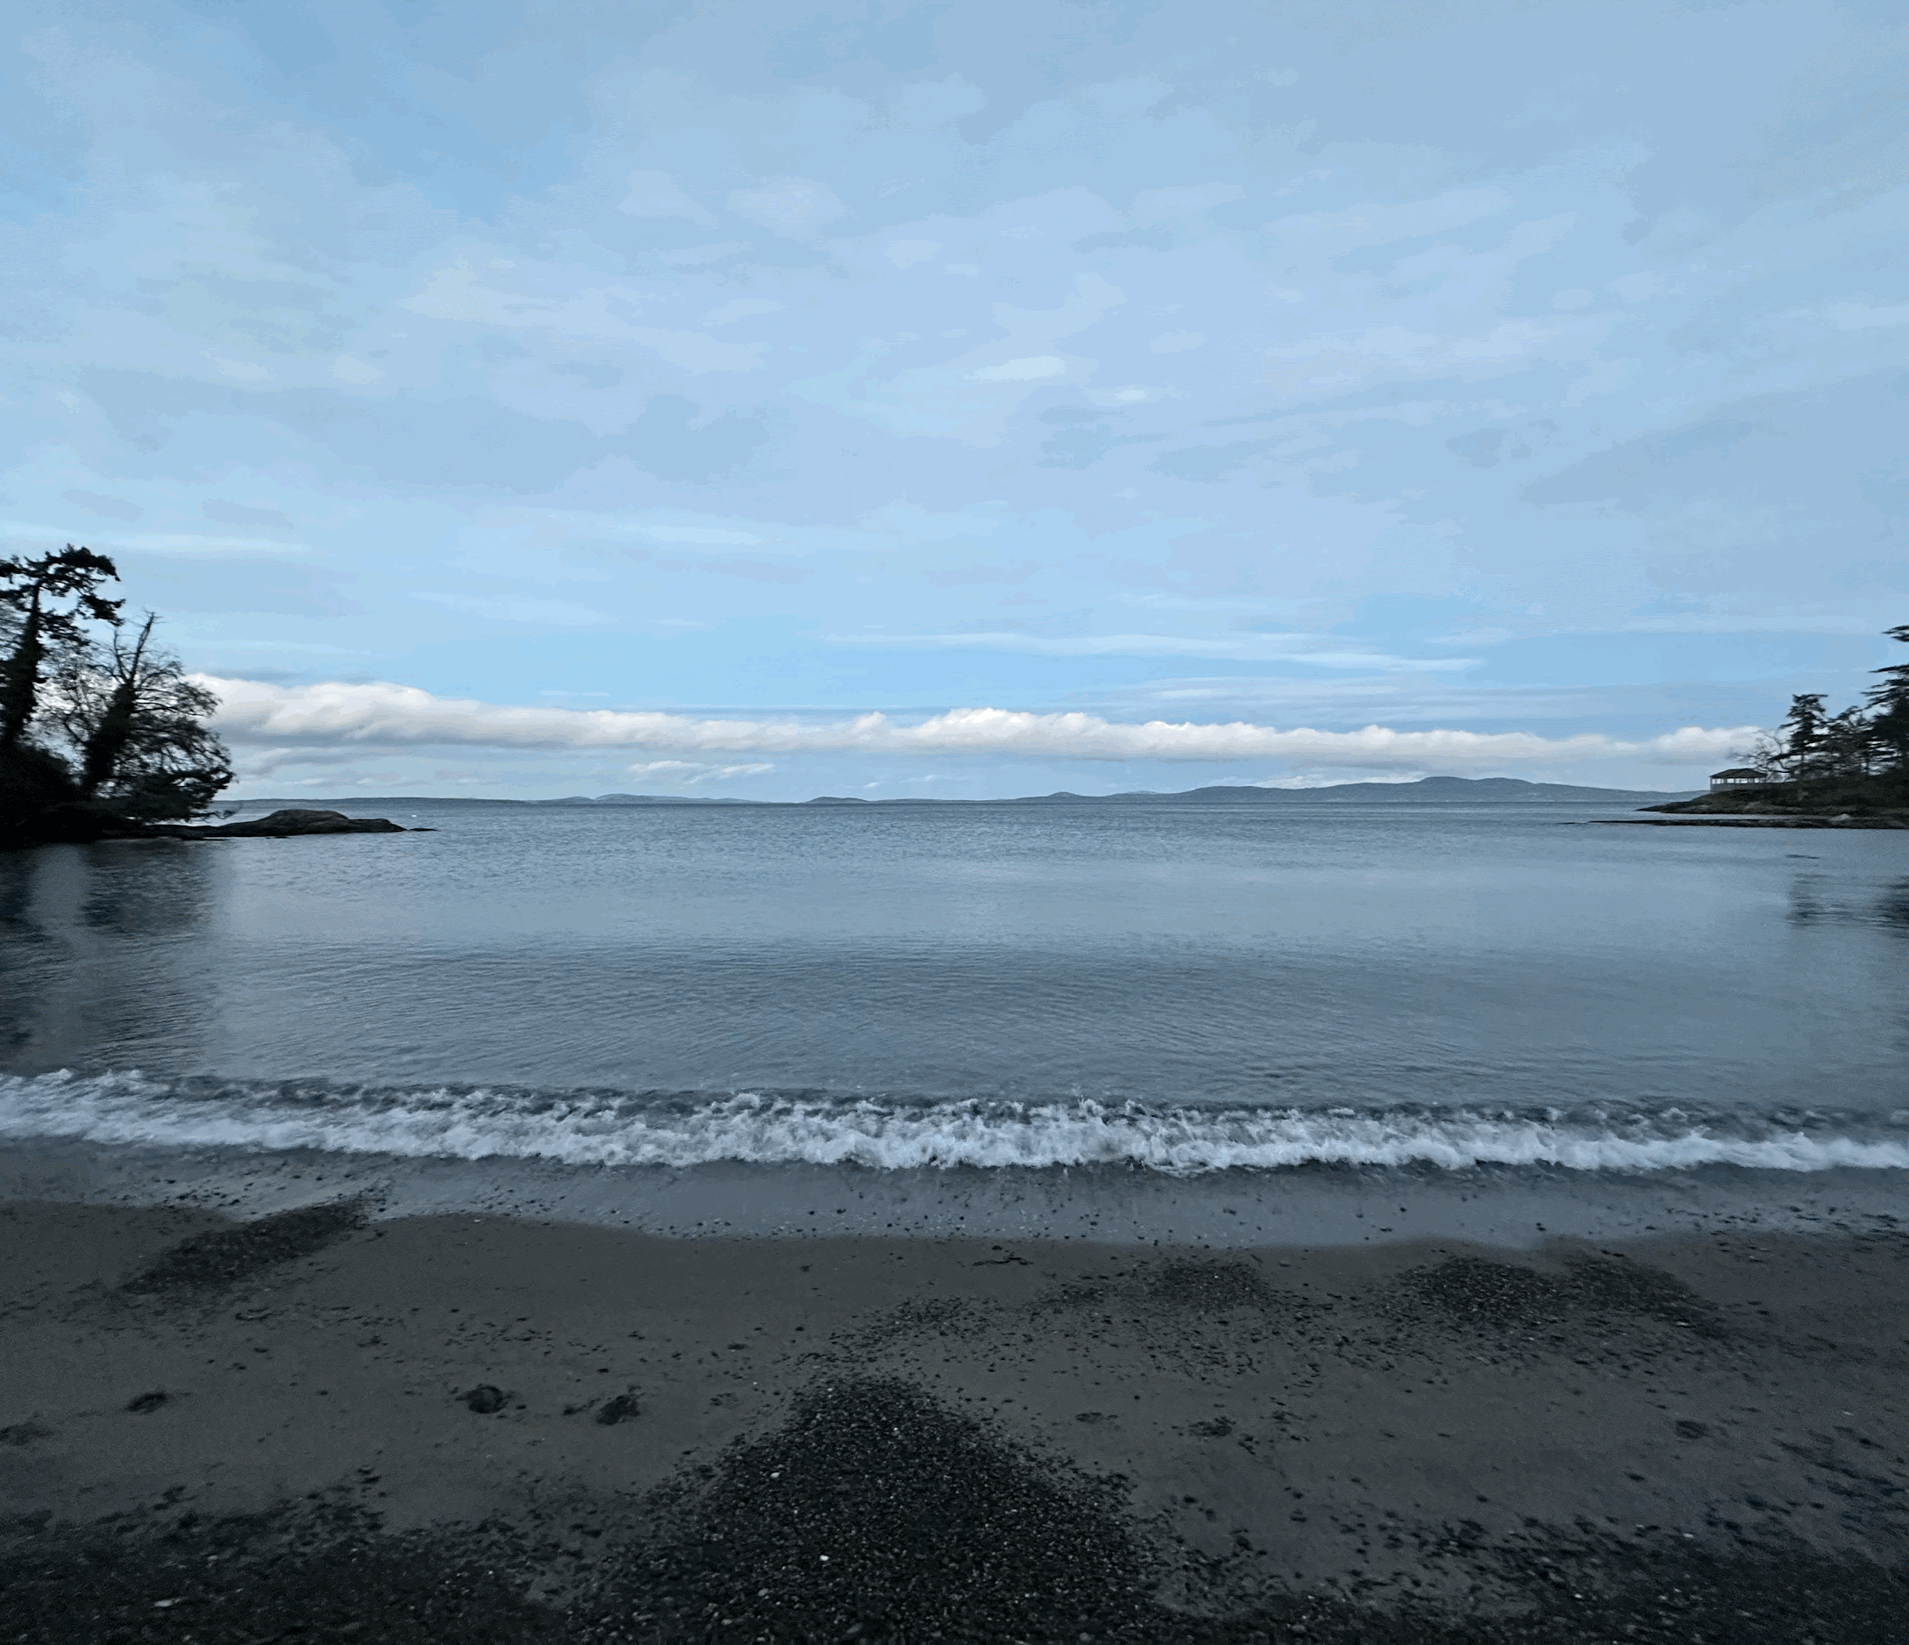
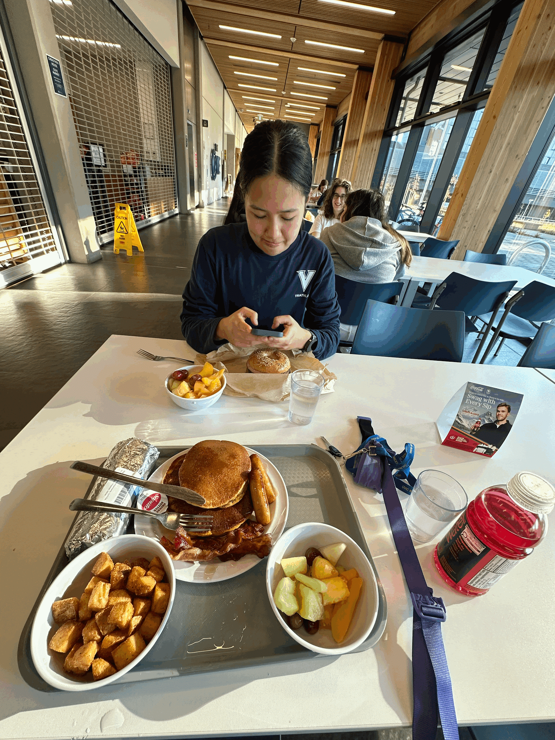
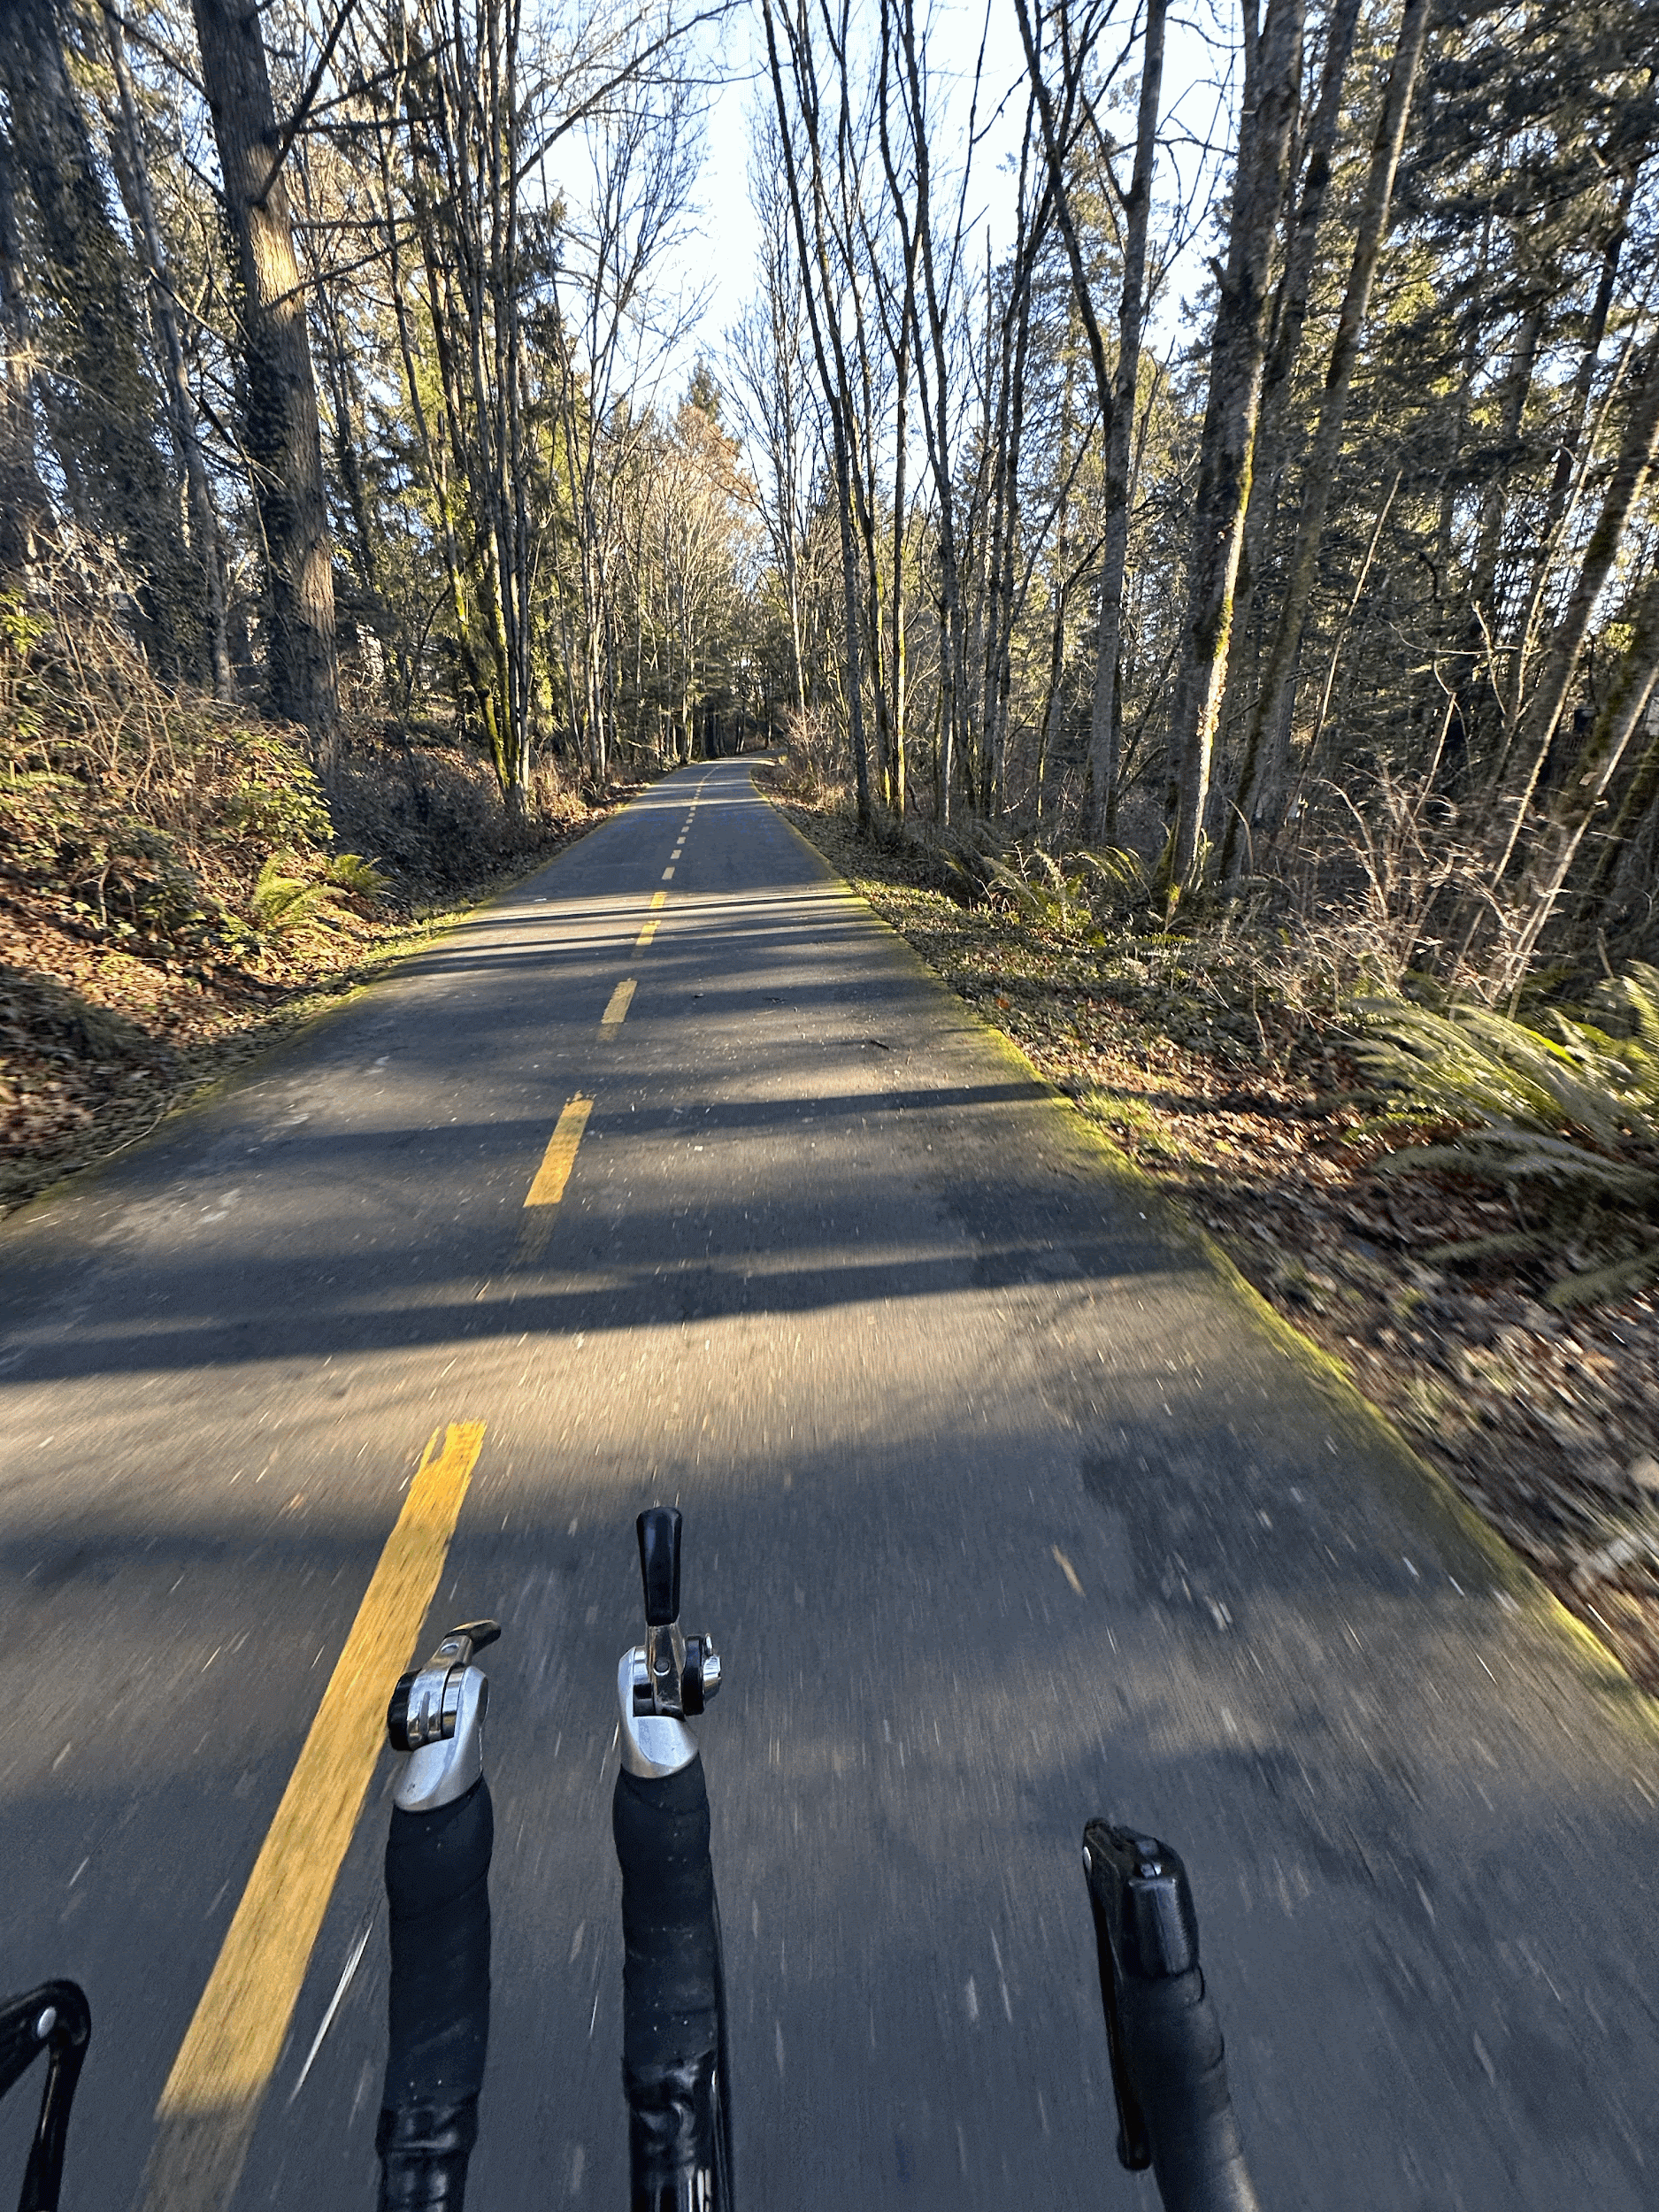
Our Hidden Gems
Cattle Point Lookout
Cadboro Bay
The Cove
Galloping Goose Trail
View Point
Beach
Restaurant
Walking/Cycling Path
A scenic lookout onto the ocean along Beach drive. Perfect for a stroll along the ocean or if you can find one during your stay, a refreshing bike ride.
A secluded beach frequented by UVic students and those brave enough to tough out against the chilly pacific for a pulsar plunge.
Our favourite place for cheap and delicious eats. A daily staple in the UVIC diet and NOT a primary cause of stomach problems or disordered eating
Experience the local active lifestyle on victoria’s 55 km long multi-use trail. This path will take you through urban, rural, and wilderness areas, allowing you to discover all parts of Victoria.

Slide 5
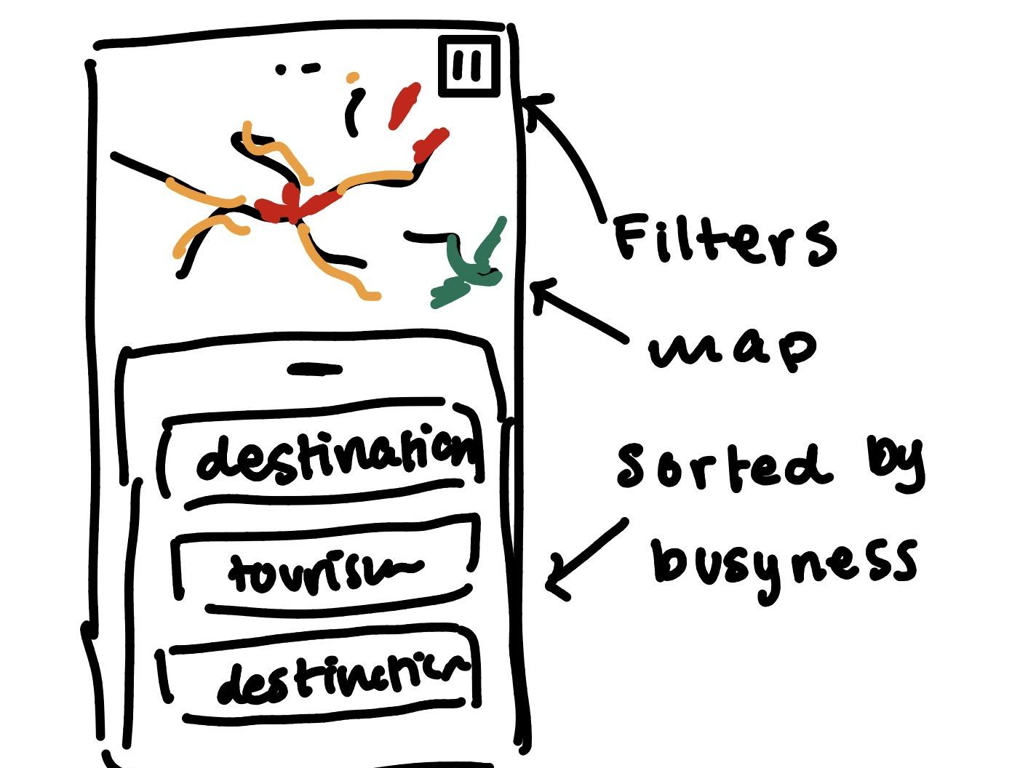
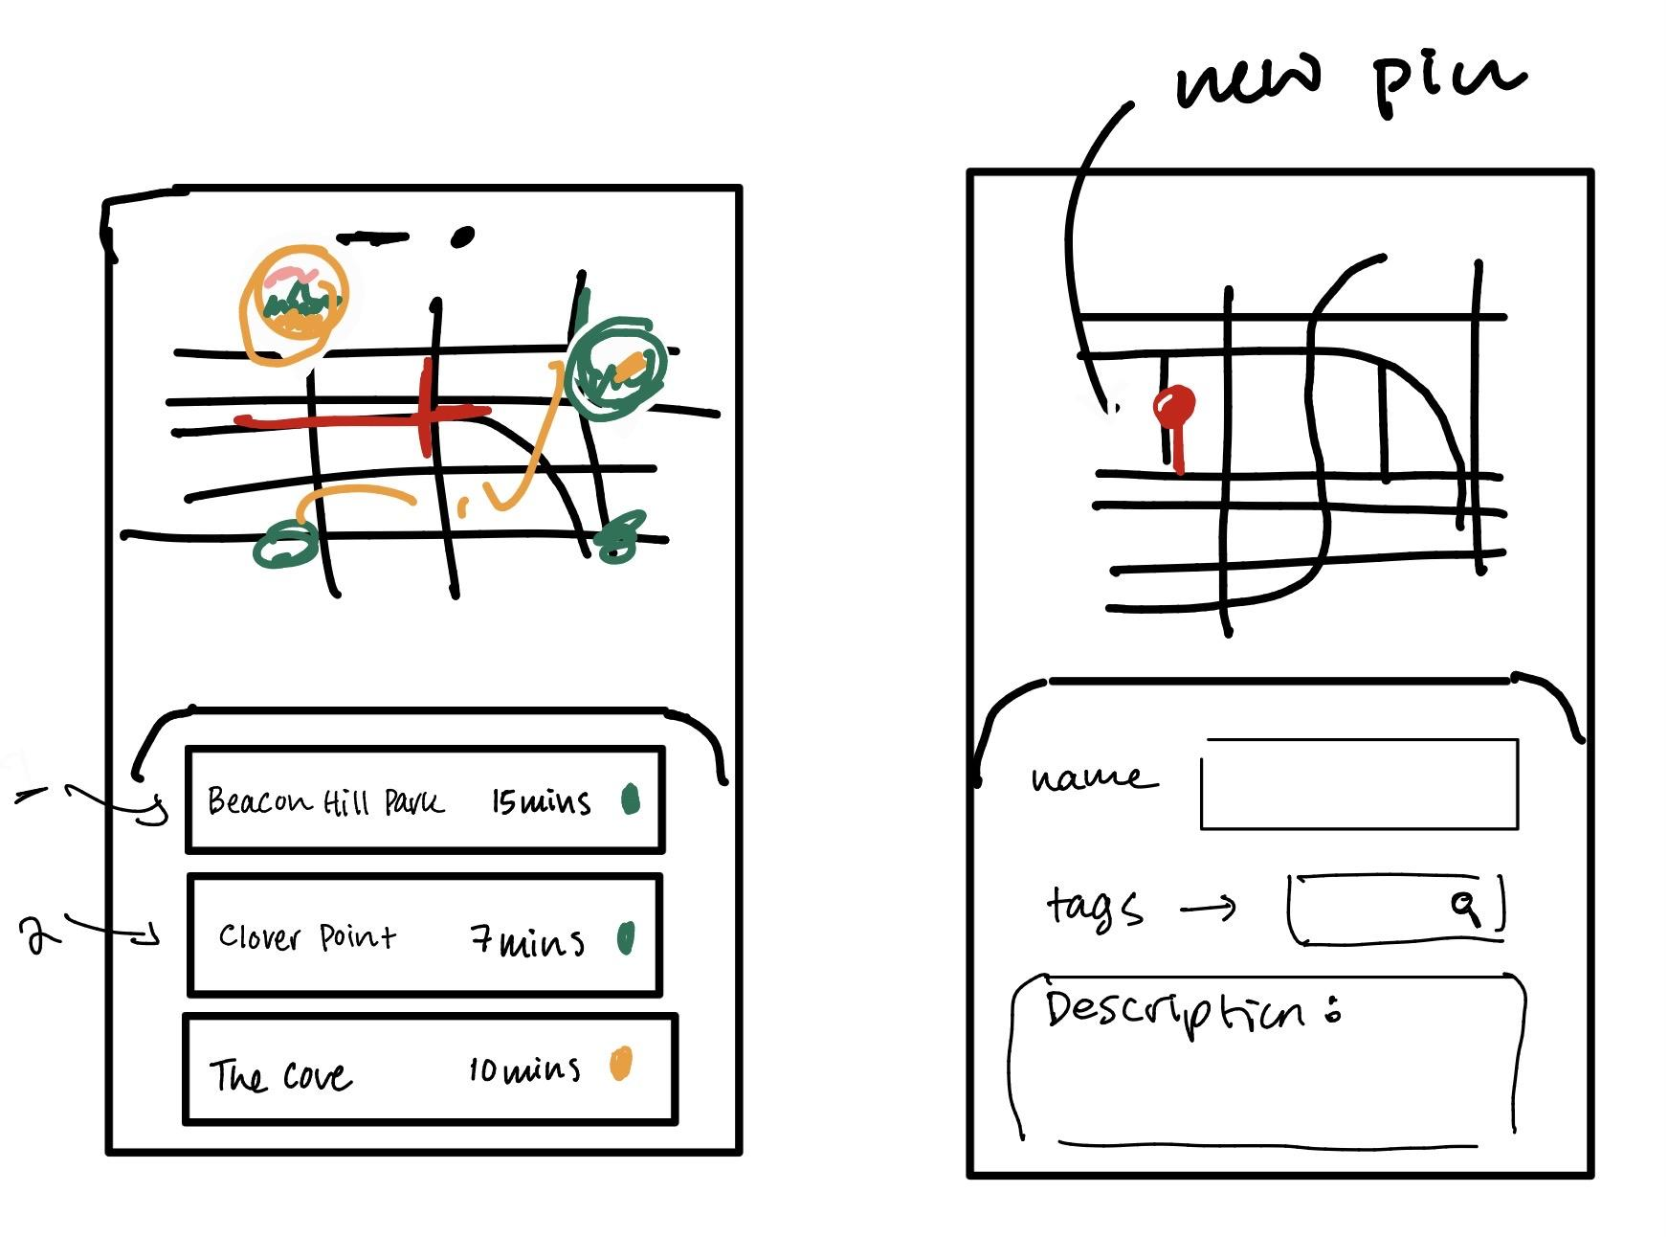
Initial Sketches

Slide 6
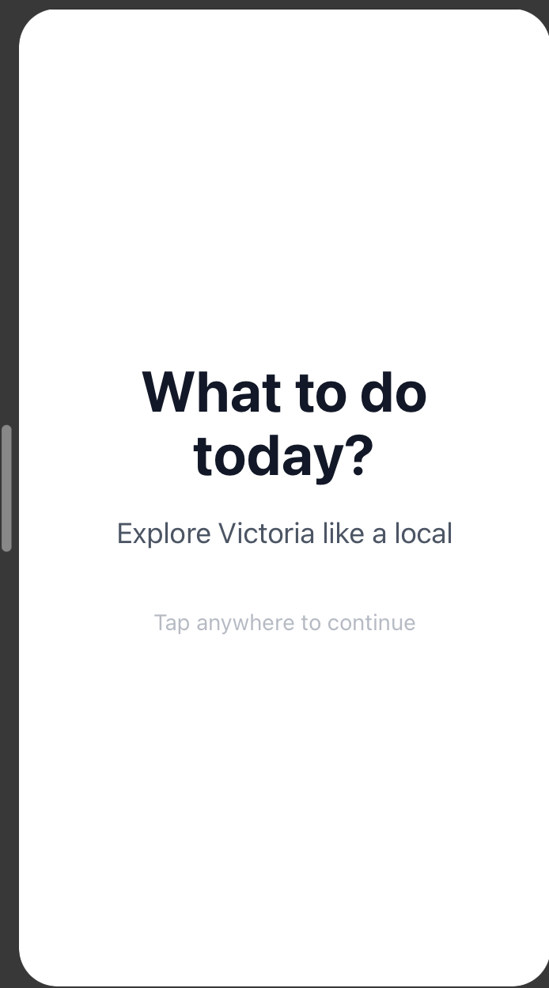
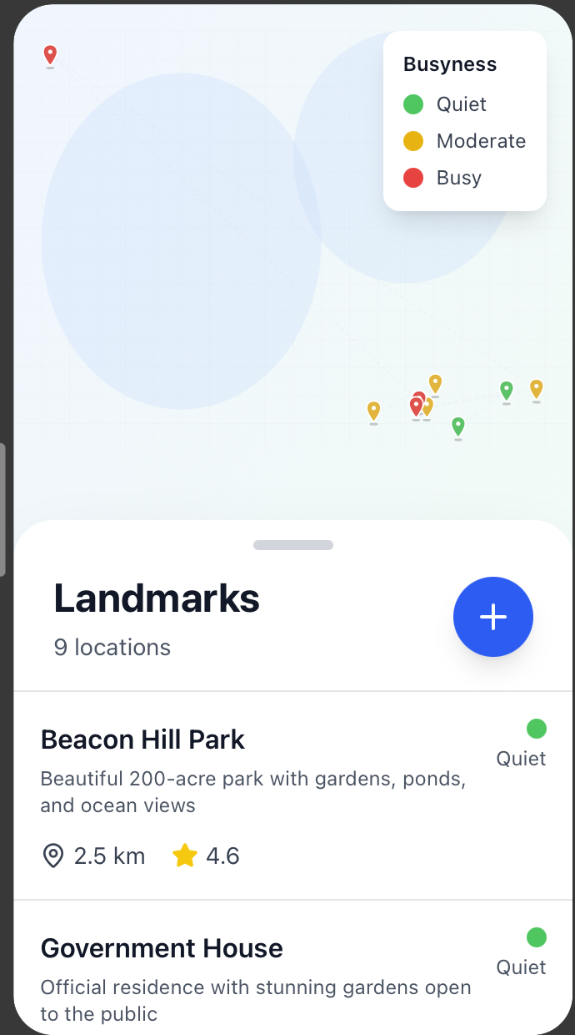
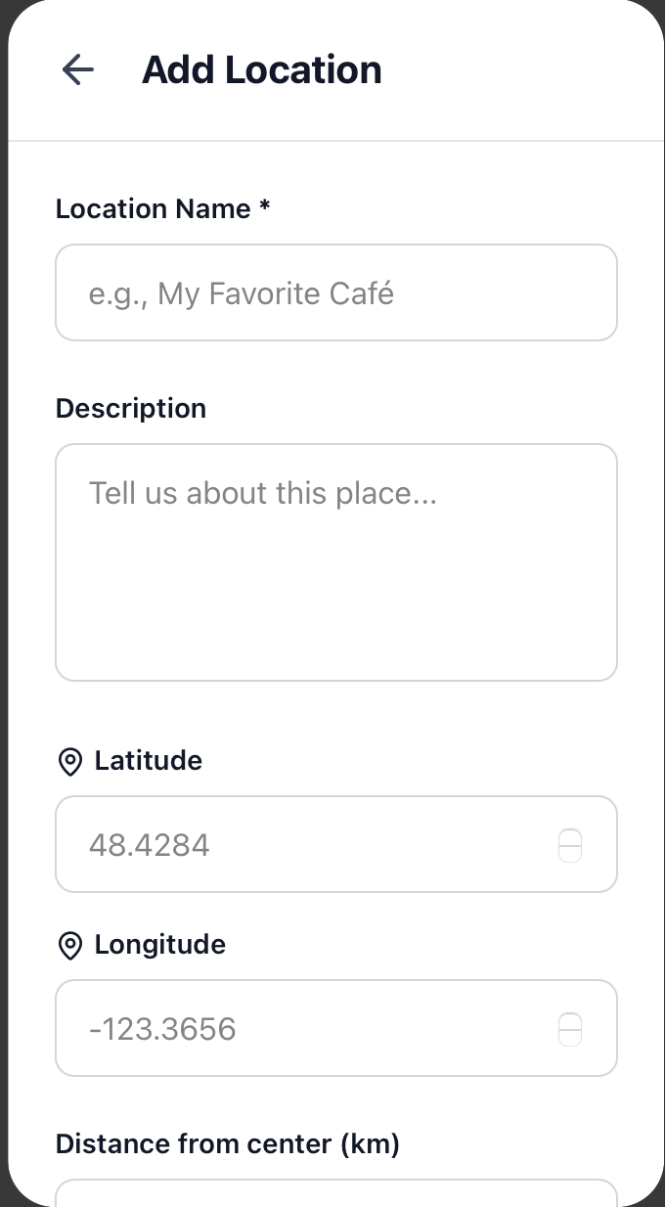
Figma Mock App

Slide 7
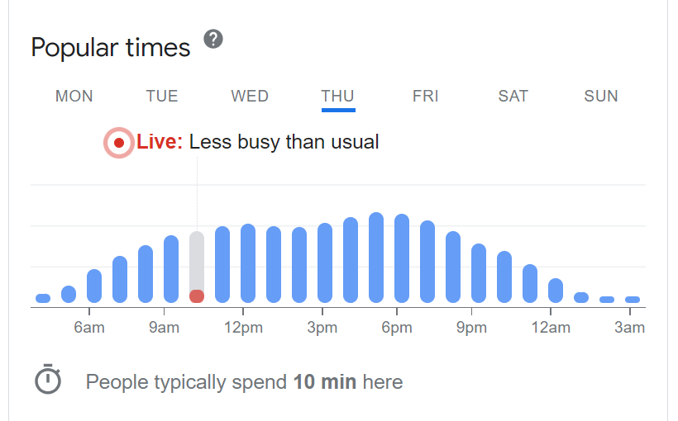

How it Works
Takes existing landmarks
Allows individuals to input destinations
Busyness based on Google’s “popular times” data
Each destination receives a busyness score
Recommends destinations based on busyness, distance, and rating

Slide 8
DEMO

Slide 9
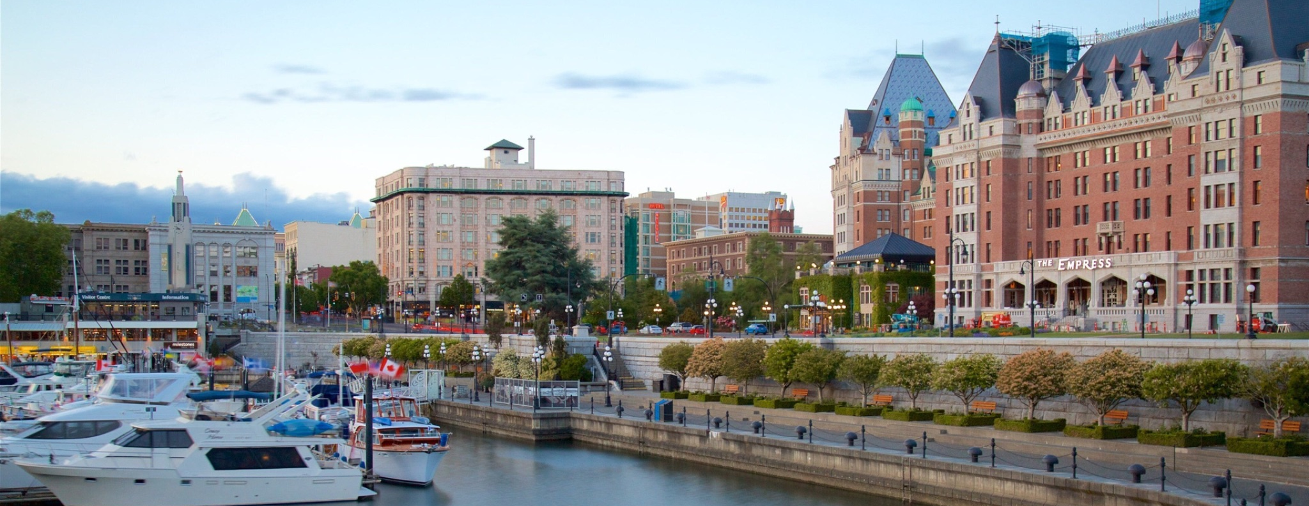

Thank you!
If you have any questions, contact:
name@example.com

